Slide 1

Chapter 8: Project Quality Management
Information Technology Project Management, Seventh Edition
Note: See the text itself for full citations.

Slide 2
Learning Objectives
Understand the importance of project quality management for information technology (IT) products and services
Define project quality management and understand how quality relates to various aspects of IT projects
Describe quality management planning and how quality and scope management are related
Discuss the importance of quality assurance
Explain the main outputs of the quality control process

Slide 3
What Is Project Quality?
The International Organization for Standardization (ISO) defines quality as “the degree to which a set of inherent characteristics fulfils requirements” (ISO9000:2000)
Other experts define quality based on:
Conformance to requirements: The project’s processes and products meet written specifications
Fitness for use: A product can be used as it was intended

Slide 4
What Is Project Quality Management?
Project quality management ensures that the project will satisfy the needs for which it was undertaken
Processes include:
Planning quality management: Identifying which quality standards are relevant to the project and how to satisfy them; a metric is a standard of measurement
Performing quality assurance: Periodically evaluating overall project performance to ensure the project will satisfy the relevant quality standards
Performing quality control: Monitoring specific project results to ensure that they comply with the relevant quality standards

Slide 5
Planning Quality
Implies the ability to anticipate situations and prepare actions to bring about the desired outcome
Important to prevent defects by:
Selecting proper materials
Training and indoctrinating people in quality
Planning a process that ensures the appropriate outcome

Slide 6
Scope Aspects of IT Projects
Functionality is the degree to which a system performs its intended function
Features are the system’s special characteristics that appeal to users
System outputs are the screens and reports the system generates
Performance addresses how well a product or service performs the customer’s intended use
Reliability is the ability of a product or service to perform as expected under normal conditions
Maintainability addresses the ease of performing maintenance on a product

Slide 7
Who’s Responsible for the Quality of Projects?
Project managers are ultimately responsible for quality management on their projects
Several organizations and references can help project managers and their teams understand quality
International Organization for Standardization (www.iso.org)
IEEE (www.ieee.org)

Slide 8
Performing Quality Assurance
Quality assurance includes all the activities related to satisfying the relevant quality standards for a project
Another goal of quality assurance is continuous quality improvement
Benchmarking generates ideas for quality improvements by comparing specific project practices or product characteristics to those of other projects or products within or outside the performing organization
A quality audit is a structured review of specific quality management activities that help identify lessons learned that could improve performance on current or future projects

Slide 9
Controlling Quality
The main outputs of quality control are:
Acceptance decisions
Rework
Process adjustments
There are Seven Basic Tools of Quality that help in performing quality control

Slide 10
Cause-and-Effect Diagrams
Cause-and-effect diagrams trace complaints about quality problems back to the responsible production operations
They help you find the root cause of a problem
Also known as fishbone or Ishikawa diagrams
Can also use the 5 whys technique where you repeated ask the question “Why” (five is a good rule of thumb) to peel away the layers of symptoms that can lead to the root cause

Slide 11
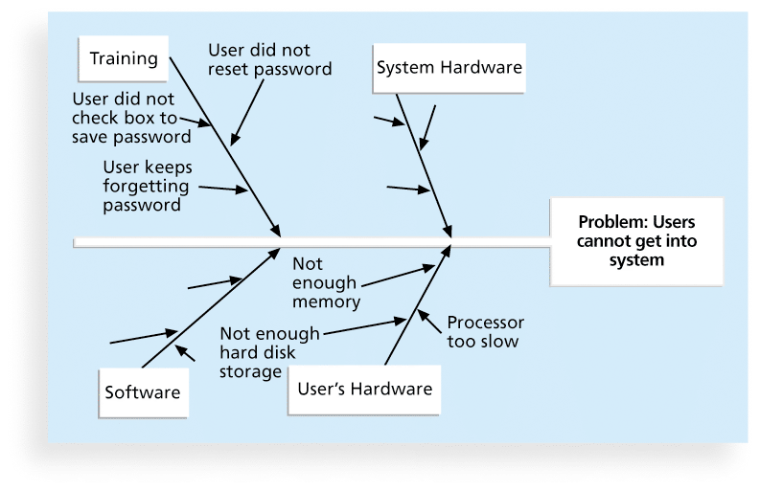
Figure 8-2. Sample Cause-and-Effect Diagram

Slide 12
Quality Control Charts
A control chart is a graphic display of data that illustrates the results of a process over time
The main use of control charts is to prevent defects, rather than to detect or reject them
Quality control charts allow you to determine whether a process is in control or out of control
When a process is in control, any variations in the results of the process are created by random events; processes that are in control do not need to be adjusted
When a process is out of control, variations in the results of the process are caused by non-random events; you need to identify the causes of those non-random events and adjust the process to correct or eliminate them

Slide 13
Checksheet
A checksheet is used to collect and analyze data
It is sometimes called a tally sheet or checklist, depending on its format
In the example in Figure 8-4, most complaints arrive via text message, and there are more complaints on Monday and Tuesday than on other days of the week
This information might be useful in improving the process for handling complaints

Slide 14
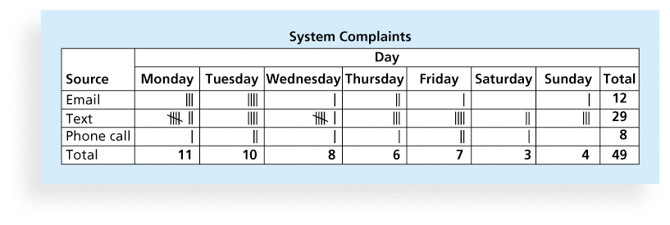
Figure 8-4. Sample Checksheet

Slide 15
Histograms
A histogram is a bar graph of a distribution of variables
Each bar represents an attribute or characteristic of a problem or situation, and the height of the bar represents its frequency

Slide 16
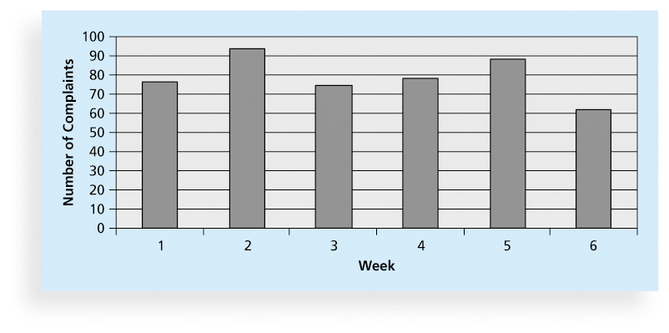
Figure 8-6. Sample Histogram

Slide 17
Pareto Charts
A Pareto chart is a histogram that can help you identify and prioritize problem areas
Pareto analysis is also called the 80-20 rule, meaning that 80 percent of problems are often due to 20 percent of the causes

Slide 18
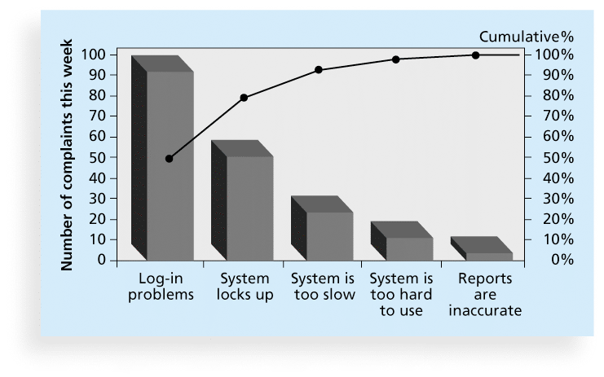
Figure 8-7. Sample Pareto Chart

Slide 19
Flowcharts
Flowcharts are graphic displays of the logic and flow of processes that help you analyze how problems occur and how processes can be improved
They show activities, decision points, and the order of how information is processed

Slide 20
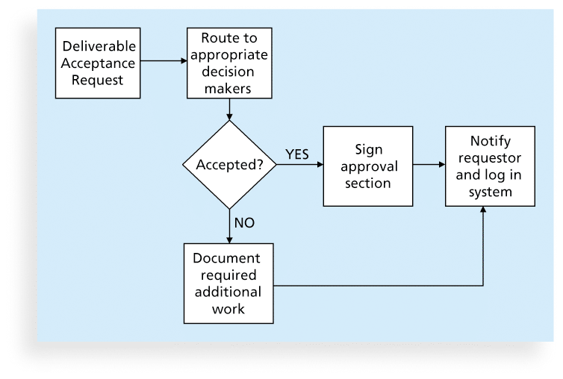
Figure 8-8. Sample Flowchart

Slide 21
Statistical Sampling
Statistical sampling involves choosing part of a population of interest for inspection
The size of a sample depends on how representative you want the sample to be
Sample size formula:
Sample size = .25 X (certainty factor/acceptable error)²
Be sure to consult with an expert when using statistical analysis

Slide 22
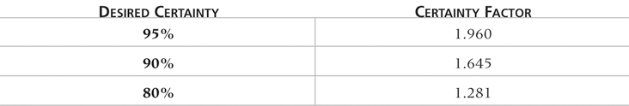
Table 8-1. Commonly Used Certainty Factors

Slide 23
Testing
Many IT professionals think of testing as a stage that comes near the end of IT product development
Testing should be done during almost every phase of the IT product development life cycle

Slide 24
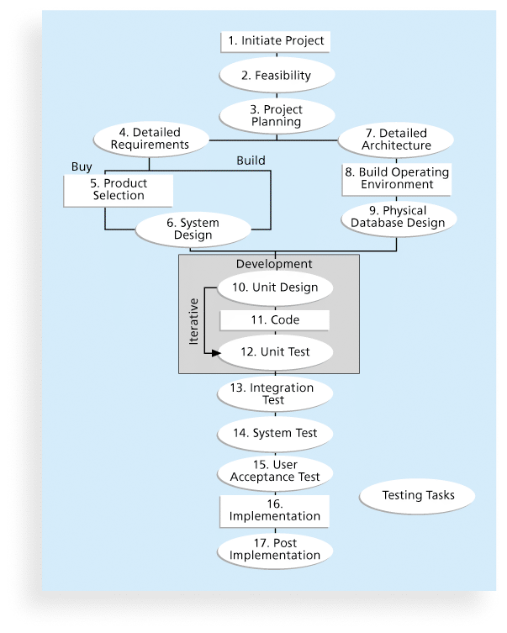
Figure 8-11. Testing Tasks in the Software Development Life Cycle

Slide 25
Types of Tests
Unit testing tests each individual component (often a program) to ensure it is as defect-free as possible
Integration testing occurs between unit and system testing to test functionally grouped components
System testing tests the entire system as one entity
User acceptance testing is an independent test performed by end users prior to accepting the delivered system

Slide 26
Testing Alone Is Not Enough
Watts S. Humphrey, a renowned expert on software quality, defines a software defect as anything that must be changed before delivery of the program
Testing does not sufficiently prevent software defects because:
The number of ways to test a complex system is huge
Users will continue to invent new ways to use a system that its developers never considered
Humphrey suggests that people rethink the software development process to provide no potential defects when you enter system testing; developers must be responsible for providing error-free code at each stage of testing

Slide 27
Modern Quality Management
Modern quality management:
Requires customer satisfaction
Prefers prevention to inspection
Recognizes management responsibility for quality
Noteworthy quality experts include Deming, Juran, Crosby, Ishikawa, Taguchi, and Feigenbaum

Slide 28
Quality Experts
Deming was famous for his work in rebuilding Japan and his 14 Points for Management
Juran wrote the Quality Control Handbook and ten steps to quality improvement
Crosby wrote Quality is Free and suggested that organizations strive for zero defects
Ishikawa developed the concepts of quality circles and fishbone diagrams
Taguchi developed methods for optimizing the process of engineering experimentation
Feigenbaum developed the concept of total quality control

Slide 29
ISO Standards
ISO 9000 is a quality system standard that:
Is a three-part, continuous cycle of planning, controlling, and documenting quality in an organization
Provides minimum requirements needed for an organization to meet its quality certification standards
Helps organizations around the world reduce costs and improve customer satisfaction
See www.iso.org for more information

Slide 30
Improving Information Technology Project Quality
Several suggestions for improving quality for IT projects include:
Establish leadership that promotes quality
Understand the cost of quality
Focus on organizational influences and workplace factors that affect quality
Follow maturity models

Slide 31
The Cost of Quality
The cost of quality is the cost of conformance plus the cost of nonconformance
Conformance means delivering products that meet requirements and fitness for use
Cost of nonconformance means taking responsibility for failures or not meeting quality expectations
A study reported that software bugs cost the U.S. economy $59.6 billion each year and that one third of the bugs could be eliminated by an improved testing infrastructure

Slide 32
Expectations and Cultural Differences in Quality
Project managers must understand and manage stakeholder expectations.
Expectations also vary by:
Organization’s culture
Geographic regions

Slide 33
Maturity Models
Maturity models are frameworks for helping organizations improve their processes and systems
The Software Quality Function Deployment Model focuses on defining user requirements and planning software projects
The Software Engineering Institute’s Capability Maturity Model Integration is a process improvement approach that provides organizations with the essential elements of effective processes

Slide 34
CMMI Levels
CMMI levels, from lowest to highest, are:
Incomplete
Performed
Managed
Defined
Quantitatively Managed
Optimizing
Companies may not get to bid on government projects unless they have a CMMI Level 3

Slide 35
Chapter Summary
Project quality management ensures that the project will satisfy the needs for which it was undertaken
Main processes include:
Plan quality
Perform quality assurance
Perform quality control

